Slide 1
Price prediction Model
Group 2:
Sajeevan Kumarasamy
Andrés Borlaf Martínez
Apinya Taweesub
Angie Valentina Martinez Paez

Slide 2
Introduction
BurgundySip is a wine store that promotes high-quality wines from all over the world
Management has decided to streamline the pricing strategy
A subset of data has been used to identify the relationship with various variables, patterns and trends in price

Slide 3
Data Handling Process
Set the objectives
Set the objectives
Import the Data
Identify the problem
Import the Data
Identify the problem
Identify the problem
Visualization and Interpretation
Visualization and Interpretation
Visualization and Interpretation
Analyse the Data
Clean the Data
Clean the Data
Model the data
Evaluation

Slide 4
Objectives
Descriptive Objectives
Predictive Objectives
Cluster based Objectives
Perform rating analysis to determine BurgundySip sells premium wine?
Identify which region produces the best wine?
How the age of the wine impact on quality?
How rating correlated with alcohol% and Sugar level?
Identify how the variables has impact on price?
Model a regression to find how rating and residual sugar level impact on price?
Model a regression to find how rating, residual sugar level, Alcohol level and density impact on price?
Identify the cluster within the depended variable
Identify the clusters by considering variables; Price and Rating

Slide 5
Data Cleaning Process
Import the data to R Studio
Variable summary:

Slide 6
Data Cleaning Process
Transform variable type (Factorise categorical variables)
Duplicate removal approach
Top down duplicate approach removal has been used as the data is less number of NA values
Duplicates has been removed based on the variable SN where 51% of the data is removed
If other categorical variable were used 72% of the data would have been removed. Hence, only variable SN was considered
Recategorization of categorical variables: Each categorical variables has a lot of categories. To make the process easy, each category variable was recategorized in to less number of categories

Slide 7
Data Cleaning Process
Outlier Treatment
Outlier test has been performed with IQR, if there is any outlier, outliers were replaced by the mean
Missing value treatment
Categorical variable: Hot desk approach has been used to treat the missing values for categorical variables
Numerical variable: Simple mean imputation and Categorical mean Imputation have been used to treat the missing values for numerical variables
Missing value in dependent variable price has been treated by predicting the values using the regression model

Slide 8
Assumptions
Missing completely at random: The probability of missingness in a variable is the same for all units
Assumed there is a monotonic relationship between the variables to perform Spearman’s correlation test

Slide 9
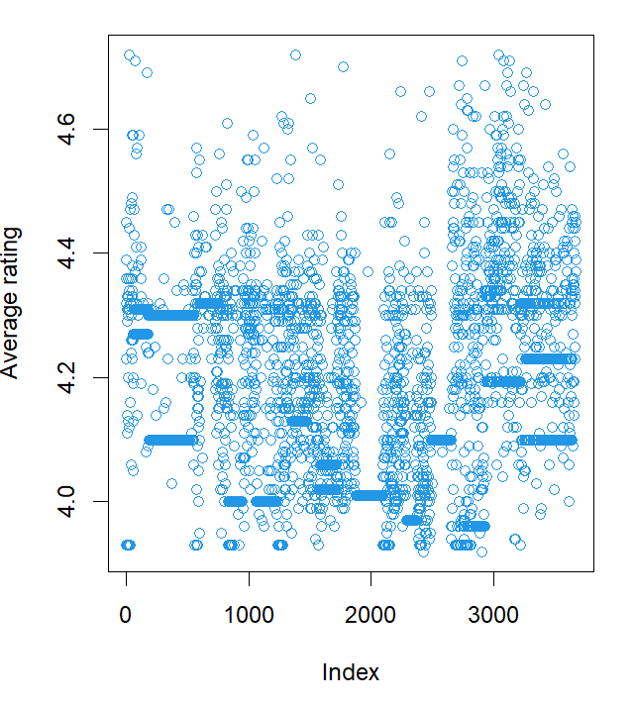
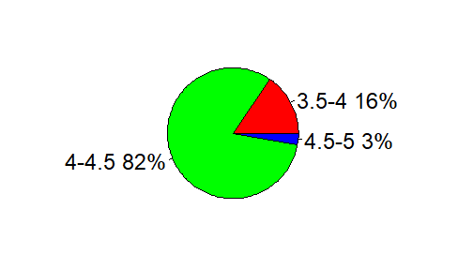
Overall Rating Analysis
The scatterplot shows the distribution of the rating of the sample
All the rating fall between 3.9 to 4.7 which shows BurgubdySip sells the premium quality wine
The pie chart shows the distribution of testers among each rating category
82% of the testers has rated between 4 and 4.5 and 3% of the testers rated 4.5 to 5
BurgundySip has a good overall rating of 4.19
Overall Rating
4.19

Slide 10
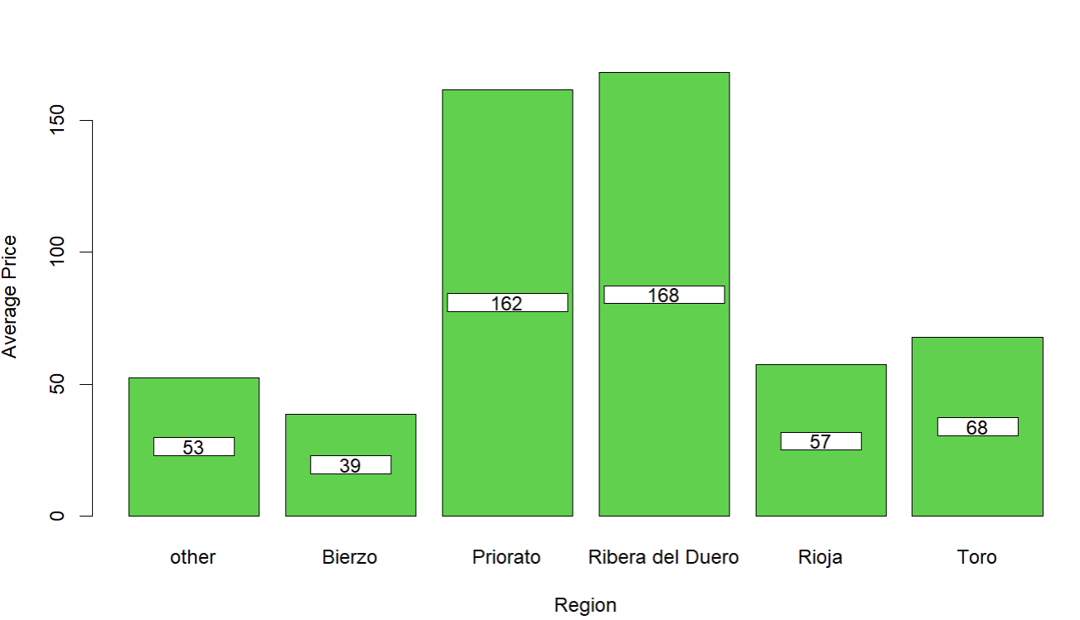
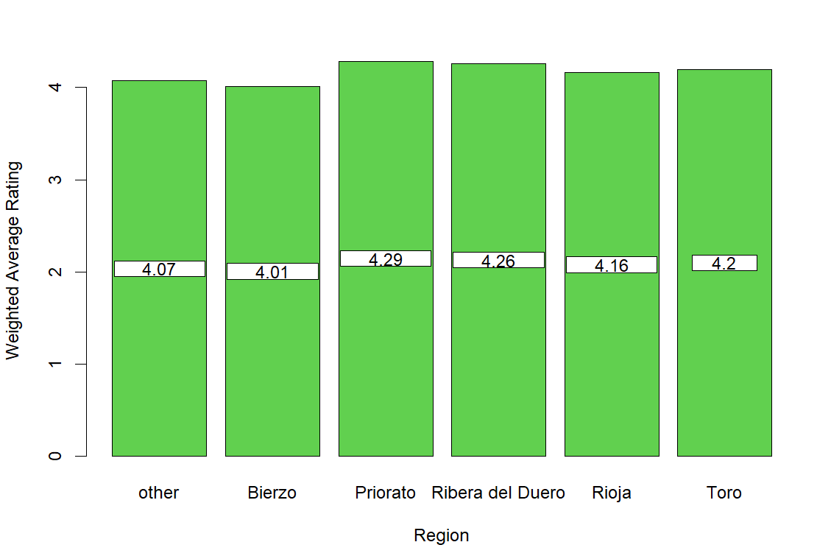
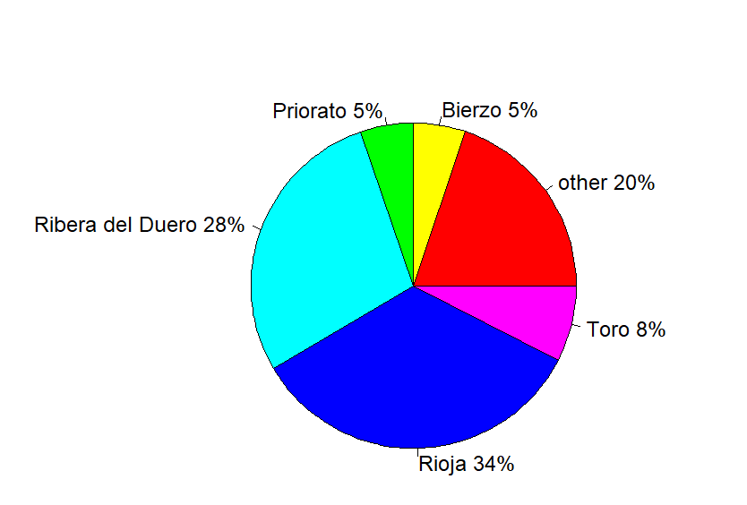
Region wise analysis
Below pie chart shows the distribution of the testers among the top 5 region
Region wise weighted average rating has been calculated to perform which region produces the best wine
The Region Ribera del Duero produces the premium wine and the rating is 4.26 for this region
Among the top 5 region, Bierzo produce the lowest price wine and also it has the lowest rating

Slide 11
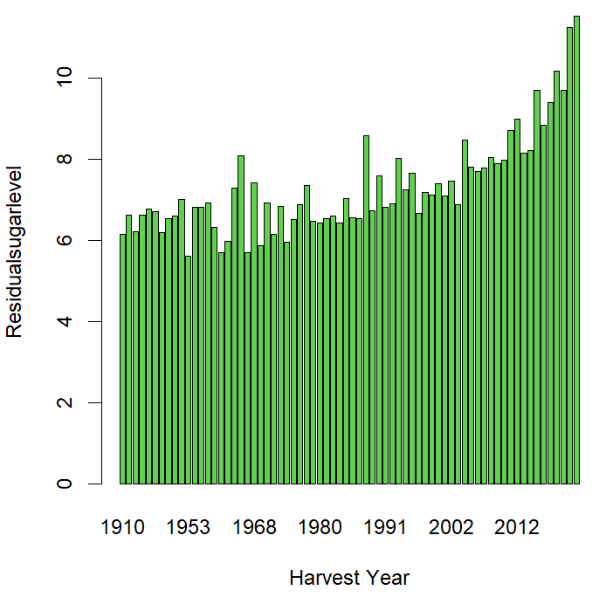
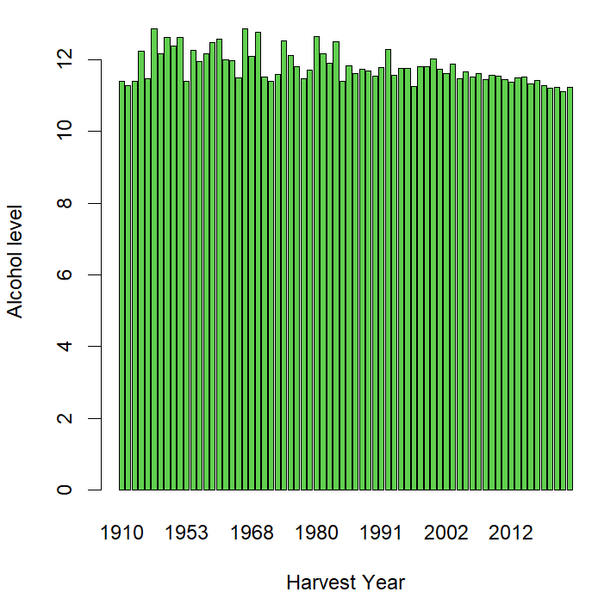
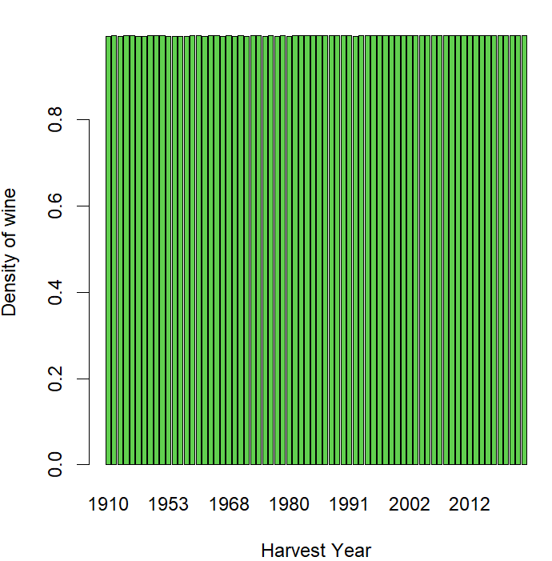
Wine Age Analysis
The bar charts were plotted to see the pattern how Residual sugar level, Alcohol % and density or gravity of wine changes with the harvest year of the grapes
Residual sugar level is high on the wine produced using the grapes from latest harvest year
Alcohol level is low on the wine produced using the grapes from latest harvest year
There is no impact on the density and gravity on the harvest year

Slide 12
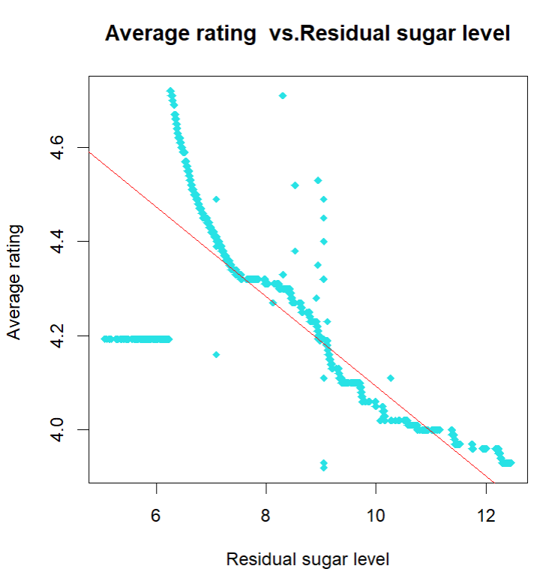
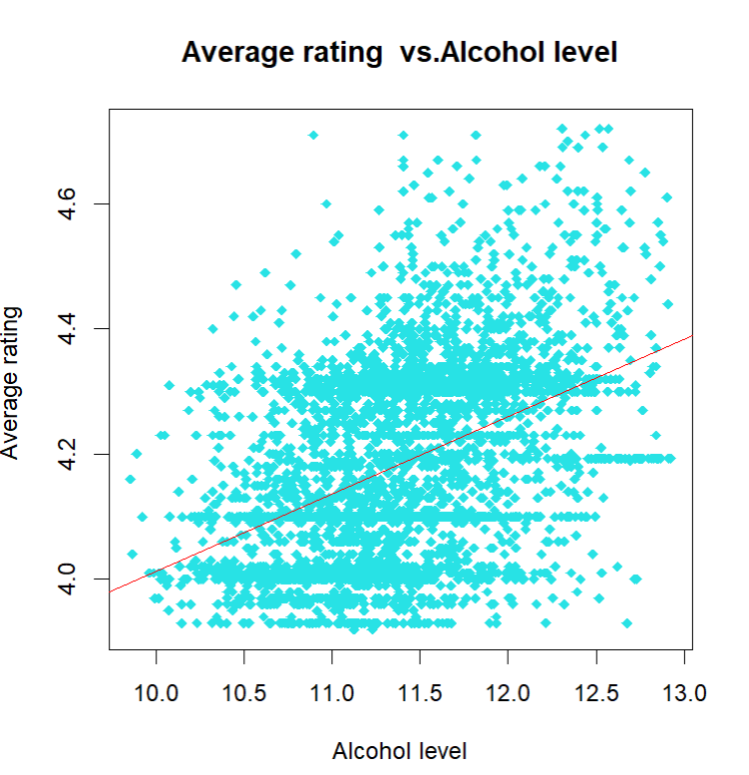
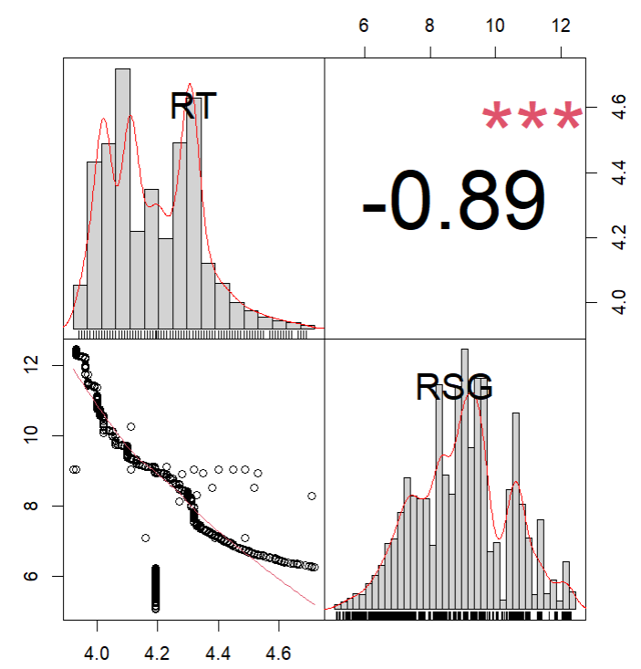
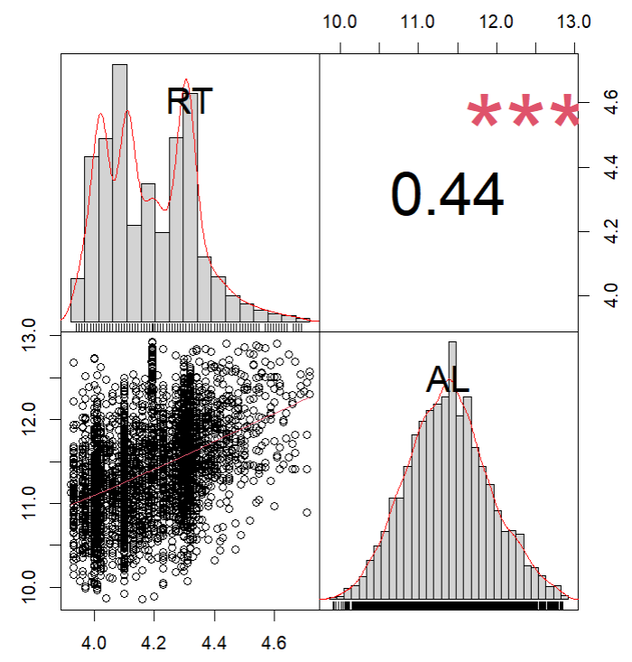
Correlation between Rating &Alcohol% & Sugar level
Residual sugar level and Alcohol % has a significant impact on the quality of the wine.
The correlation analysis shows rating and residual sugar level has a strong negative relationship (correlation coefficient = -0.89)
Alcohol % and the rating has a weak positive correlation (correlation coefficient = 0.44)

Slide 13
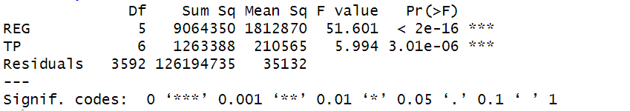
How variable impact on Price?
Price vs categorical variables; Region and Wine variety
ANOVA test is performed to identify the correlation between a numeric variable (price) and categorical variables (Region and Wine variety)
As the P-value is less than 0.05 for both categorical variables, null hypothesis was rejected. Hence, price is dependent on region and wine variety.
As categorical variable has impact on price, to measure the correlation coefficient these variables are converted to integers

Slide 14
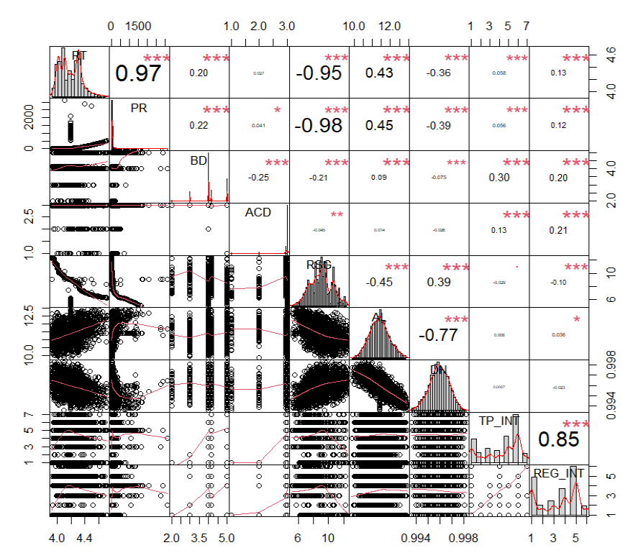
How variable impact on Price?
Price vs Numerical variables; Body score, Acidity level, Residual sugar level, Alcohol level & density
Spearman’s correlation test was performed to find how each variable has correlated with price
Price and rating has a strong positive relationship with correlation coefficient 0.97
Price and residual sugar level has a strong negative relationship with coefficient -0.98
Alcohol level has a weak positive relationship with price with coefficient 0.45
Density has a weak negative relationship with price with coefficient -0.39
Acidity level has no impact on price
Body score also has a very weak relationship with price with coefficient 0.22
Categorical variable Region and wine variety has very weak positive relationship with price with coefficient 0.056 & 0.12 respectively

Slide 15
Regression Model
Correlation analysis shows Price and other variables has a non-linear relationship
Therefore, a non-liner regression was modelled to predict the dependent variable; price
Two non-linear regression were modelled with variable to predict the price
Data was divided in to two as train data and test data. Test data was with NA values
Test data was used to model non-linear regression
Modelled regression was used to predict the NA values in the test data

Slide 16
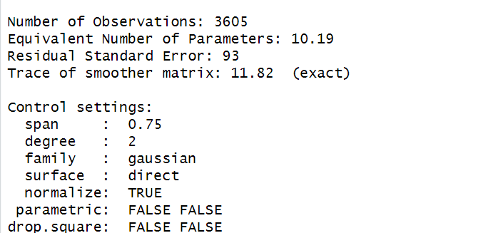
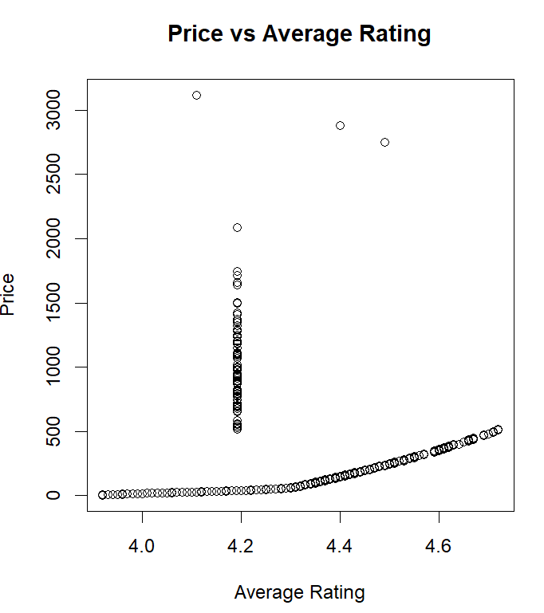
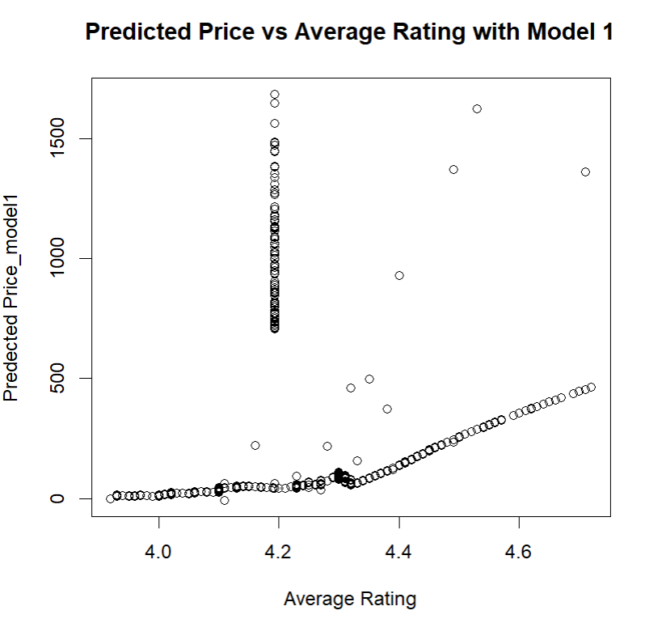
Regression Model 1
In this model, independent variables, residual sugar level and average rating were considered
The model non-linear regression has a residual standard error of 93
Price was predicted using non-linear model
The scatter plot shows the price from the data and the predicted price using the above model against average rating

Slide 17
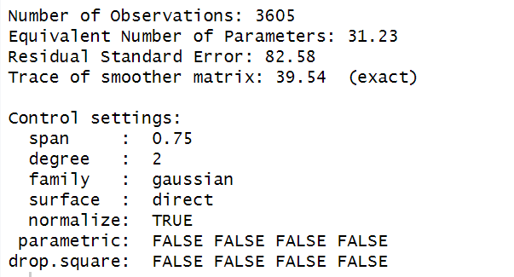
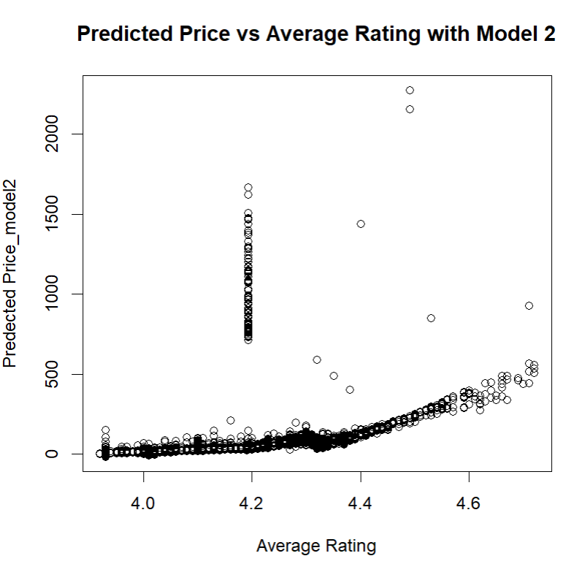
Regression Model 2
In this model, independent variables, residual sugar level, average rating, Alcohol level and density were considered
The model non-linear regression has a residual standard error of 82.58
Price was predicted using non-linear model
The scatter plot shows the price from the data and the predicted price using the above model against average rating

Slide 18
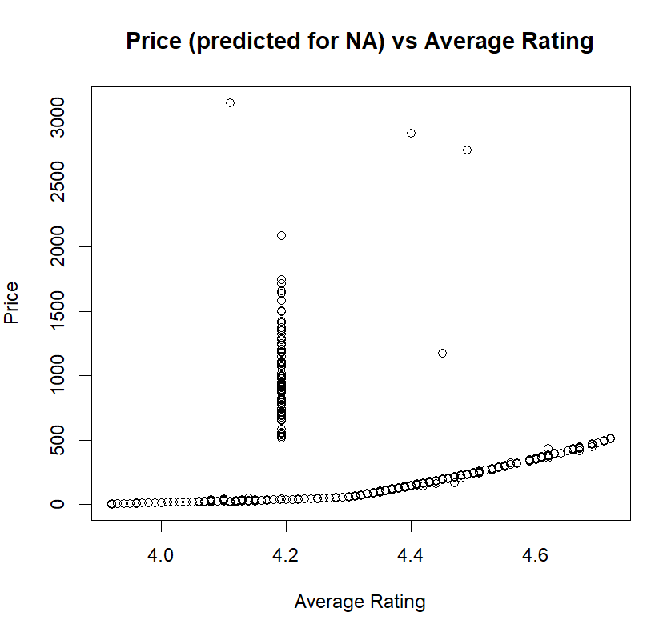
Prediction
Non-linear model 2 has the lowest residual standard error
Therefore, Non-linear model 2 was used to predict the NA values for depended variable; price
The scatterplot shows the data before and after replace NA values with non-linear model

Slide 19
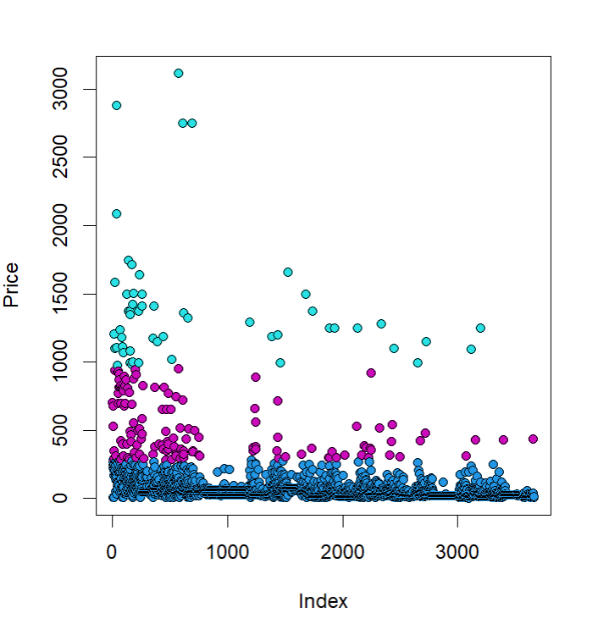
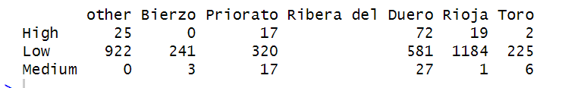

Cluster Analysis
Univariate Cluster Analysis
Under univariate cluster analsysi, Dependent variable Price has been clustered in to 3 and name as Low , Medium and High
Chi-square test and dependence test has been performed to find out how Price clusters related with Region
As per the test (p<0.05), both cluster and region variables are dependents

Slide 20
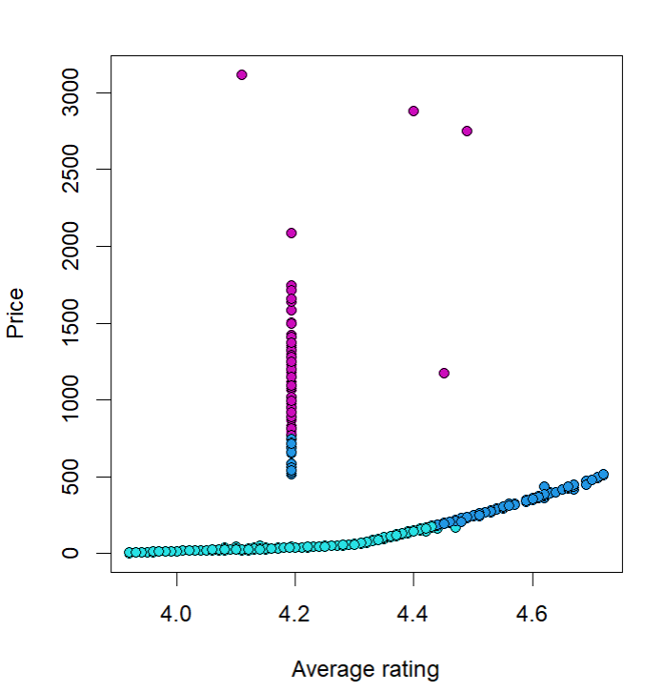
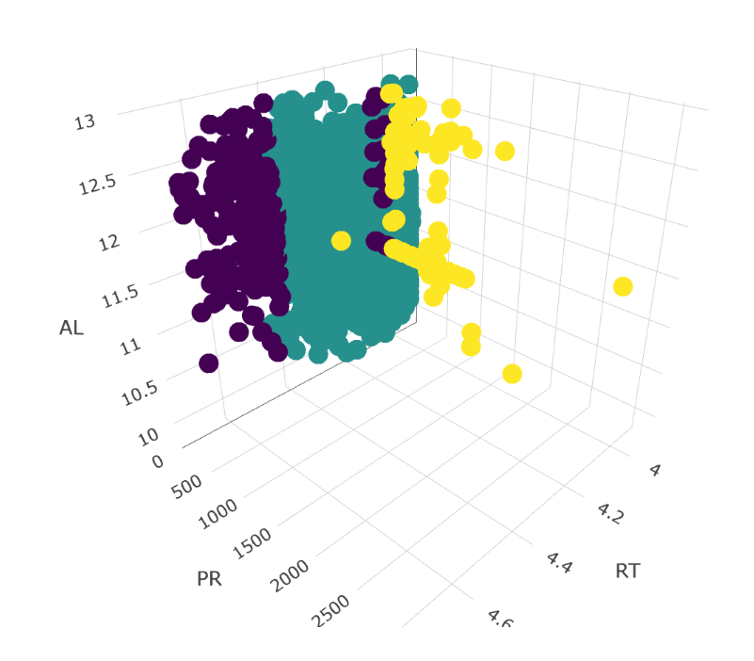
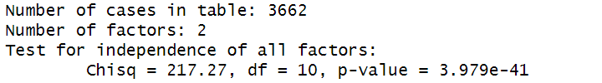

Cluster Analysis
Multivariate Cluster Analysis
Under multivariate cluster analysis, Price and Average rating has been used to cluster in to 3 and the clusters are named as Low , Medium and High
Chi-square test and dependence test has been performed to find out how these clusters related with Region
As per the test (p<0.05), both cluster and region variables are dependents

Slide 21
Recommendation
The modelled non-linear regression can be used to predict the process to streamline the price of the wine in Burgundy sip
Cluster based promotion can be done to promote the wine based on the clusters

